Slide 1
Resurrection of a Clock
Hanyu Yao
hy2612

Slide 2
The "creature" in this project is a sunken clock. After being salvaged, the clock "came back to life" and began to manipulate the flow of time.

Slide 3
Wave
The waves in the landscape of the project is created by vertex.To have two waves, I created a sin wave and a cos wave.
Reference:
https://editor.p5js.org/stevenraysimon/sketches/HyTseadOg

Slide 4
https://www.youtube.com/watch?v=7vABBy46v1w
This video shows the day and night cycle. The cycle is accelerated or decelerated according to the time flow controlled by the clock(and the clock is determined by the user).

Slide 5
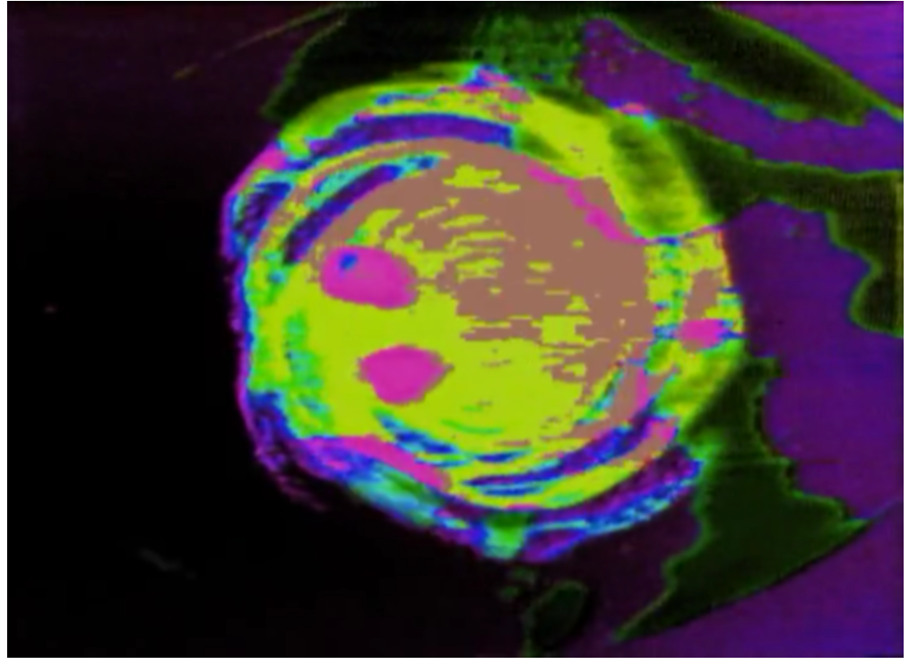
The movement of the “creature” clock is simulated by rotating matters in its surroundings. I intended to achieve this by creating different rings rotating in different velocities.
http://lillian.com/films/
(The work I referred to is “Galaxy”)

